Slide 1

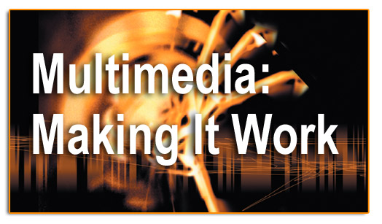
INTRODUCTION TO IMAGES

Slide 2
OBJECTIVES
Discuss the various factors that apply to the use of images in multimedia.
Describe the capabilities and limitations of bitmap images.
Describe the capabilities and limitations of vector images.
Describe the use of colors and palettes in multimedia.
Cite the various file types used in multimedia.

Slide 3
OVERVIEW
Creation of multimedia images.
Creation of still images.
Colors and palettes in multimedia.
Image file types used in multimedia.

Slide 4
CREATION OF MULTIMEDIA IMAGES
Images obviously play a very important role in multimedia products
  Images may be photograph-like bitmaps, vector-based drawings, or 3D renderings
The type of still images created depends on the display resolution, and hardware and software capabilities.
Access to the right tools and right hardware for image development is important!
  E.g., graphic designers like to have large, high-resolution monitors or multiple monitors

Slide 5
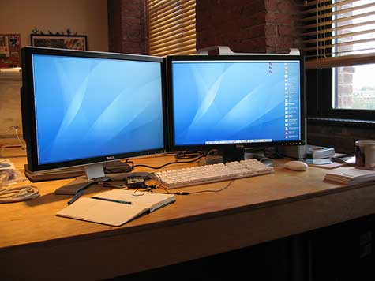
MULTIPLE MONITORS
Multi-monitor, also called multi-display and multi-head, is the use of multiple physical display devices, such as monitors, televisions, and projectors, in order to increase the area available for computer programs running on a single computer system.

Slide 6
TYPES OF STILL IMAGES
Still images are generated in two ways:
  Bitmaps (or raster-based).
  Vector-drawn graphics.

Slide 7
BITMAPS
Bitmap is derived from the words ‘bit’, which means the simplest element in which only two digits are used, and ‘map’, which is a two-dimensional matrix of these bits.
A bitmap is a data matrix describing the individual dots of an image that are the smallest elements (pixels) of resolution on a computer screen or printer.

Slide 8
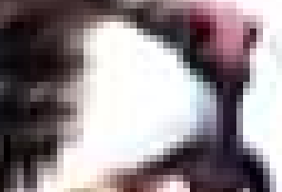
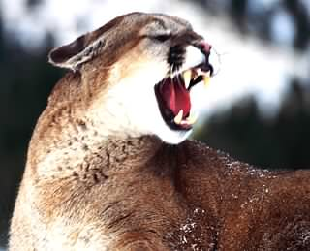
Example

Slide 9
BITMAPS CONTD..
Bitmaps are an image format suited for creation of:
  Photo-realistic images.
  Complex drawings.
  Images that require fine detail.
Bitmapped images are known as paint graphics.
Bitmapped images can have varying bit and color depths.

Slide 10
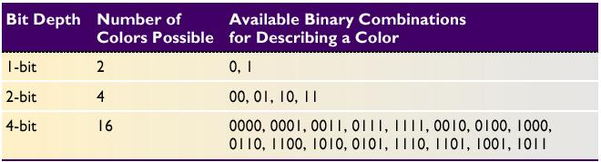
BITMAPS CONTD..
More bits provide more color depth, hence more photo-realism;
      but require more memory and processing power
Available binary Combinations for Describing a Color

Slide 11
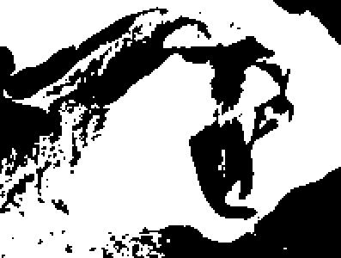
Monochrome just requires one bit per pixel, representing black or white
BMP – 16 KB

Slide 12
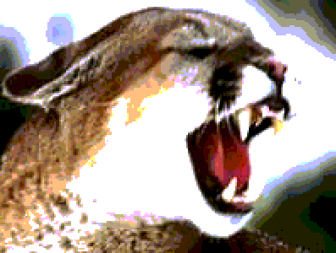
8 bits per pixel allows 256 distinct colors
BMP – 119KB

Slide 13
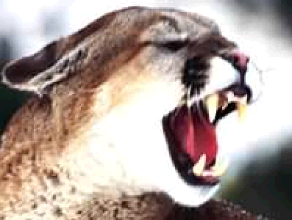
16 bits per pixel represents 32K distinct colors (Most graphic chipsets now supports the full 65536 colors and the color green uses the extra one bit)
BMP – 234 KB

Slide 14

24 bits per pixel allows millions of colors
32 bits per pixel – trillion of colors
BMP – 350KB

Slide 15
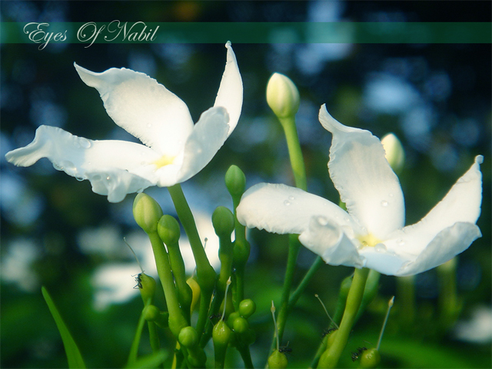
Bitmaps are best for photo-realistic images or complex drawings requiring fine detail

Slide 16

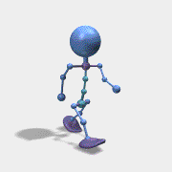


Bitmaps picture and their suitability of use:-
  Use the native Microsoft bmp format as a raw image that will later be processed. It is faster to process.
  Use JPEG, for photo sharing on the web because of its size and quality.
  GIF is normally used for diagrams, buttons, etc., that have a small number of colors
    It is also suitable for simple animation because it supports interlaced images.
  PNG is almost equal to GIF except that it didn’t support the animation format.

Slide 17
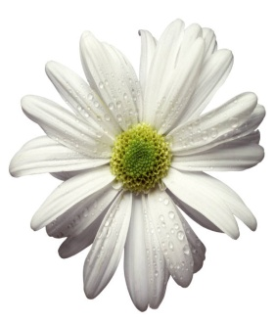
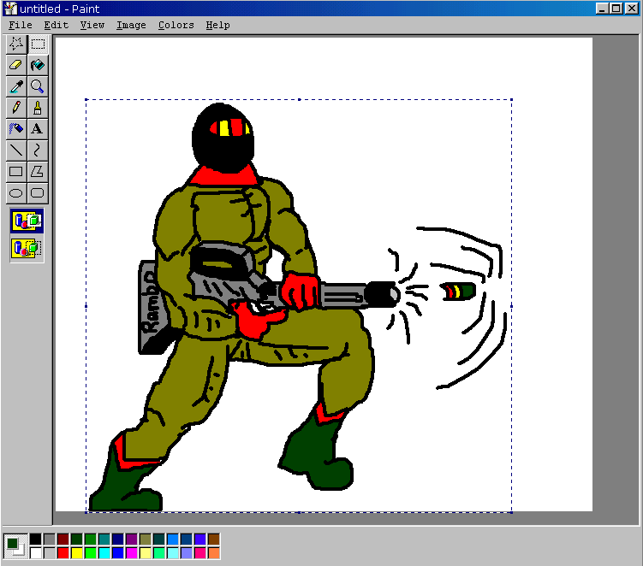
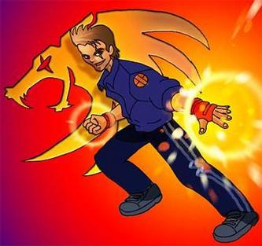
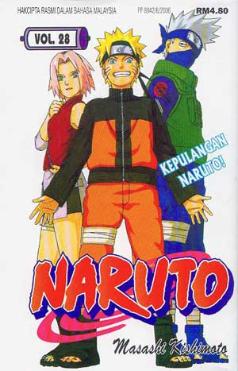
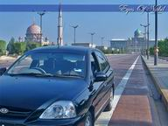
BITMAPS
Bitmaps can be inserted by:
  Using clip art galleries.
  Using bitmap software.
  Capturing and editing images.
  Scanning images.
Clip Art
Drawn
Capture
Scan

Slide 18
USING CLIP ART GALLERIES
A clip art gallery is an assortment of graphics, photographs, sound, and video.
Clip arts are a popular alternative for users who do not want to create their own images.
Clip arts are available on CD-ROMs and on the Internet.

Slide 19
USING BITMAP SOFTWARE
The industry standard for bitmap painting and editing programs are:
    Adobe's Photoshop and Illustrator.
    Macromedia's Fireworks.
    Corel's Painter.
    CorelDraw.
    Quark Express.

Slide 20
CAPTURING AND EDITING IMAGES
Capturing and storing images directly from the screen is another way to assemble images for multimedia.
The PRINT SCREEN button in Windows copies the screen image to the clipboard.

Slide 21
CAPTURING AND EDITING IMAGES CONTD..
Image editing programs enable the user to:
  Enhance and make composite images.
  Alter and distort images.
  Add and delete elements.
  Morph (manipulate still images to create animated transformations).

Slide 22
SCANNING IMAGES
Users can scan images from conventional sources and make necessary alterations and manipulations.

Slide 23
APPLICATIONS OF VECTOR-DRAWN IMAGES
Vector-drawn images - created from geometric objects such as lines, rectangles, ovals, polygons using mathematical formulas
Vector-drawn images are used in the following areas:
  Computer-aided design (CAD) programs.
  Graphic artists designing for the print media.
  3-D animation programs.
  Applications requiring drawing of graphic shapes.

Slide 24
HOW VECTOR-DRAWN IMAGES WORK
A vector is a line that is described by the location of its two endpoints.
Vector drawing makes use of Cartesian co-ordinates.
Cartesian coordinates are numbers that describe a point in two or three-dimensional space as the intersection of X, Y, and Z axis.
Y
Z
X

Slide 25
Example
RECT 0,0,200,300,RED,BLUE says
  “Draw a rectangle starting at 0,0 (upper left corner of screen) going 200 pixels horizontally right and 300 pixels downward, with a RED boundary and filled with BLUE.”
200 pixel
300 pixel

Slide 26
VECTOR-DRAWN IMAGES V/S BITMAPS
Vector images use less memory space and have a smaller file size as compared to bitmaps.
For the Web, pages that use vector graphics in plug-ins download faster, and when used for animation, draw faster than bitmaps.

Slide 27
VECTOR-DRAWN IMAGES V/S BITMAPS CONTD..
Vector images cannot be used for photorealistic images.
Vector images require a plug-in for Web-based display.
Bitmaps are not easily scalable and resizable.
Bitmaps can be converted to vector images using auto tracing.

Slide 28
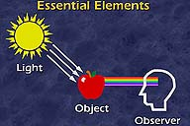
HOW TO SEE COLOR?
To see color, three essential elements must be present:
light,
an illuminated object,
and an observer.

Slide 29
NATURAL LIGHT AND COLOR
Light comes from an atom where an electron passes from a higher to a lower energy level.
Each atom produces uniquely specific colors.
Color is the frequency of a light wave within the narrow band of the electromagnetic spectrum, to which the human eye responds.

Slide 30
UNDERSTANDING NATURAL LIGHT AND COLOR
The tools we use to describe color are different when the color is printed than from when it is projected
  Additive color (projected color).
  Subtractive color (printed color).
  Monitor-specific color.
  Color models.

Slide 31
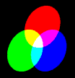
ADDITIVE COLOR
In the additive color method, a color is created by combining colored light sources in three primary colors - red, green, and blue (RGB).
TV and computer monitors use this method.

Slide 32

SUBTRACTIVE COLOR
In the subtractive color method, color is created by combining colored media such as paints or ink.
The colored media absorb (or subtract) some parts of the color spectrum of light and reflect the others back to the eye.

Slide 33
SUBTRACTIVE COLOR CONTD..
Subtractive color is the process used to create color in printing.
The printed page consists of tiny halftone dots of three primary colors- cyan, magenta, and yellow (CMY).

Slide 34
MONITOR-SPECIFIC COLORS
Colors should be used according to the target audience's monitor specifications.
The preferred monitor resolution is 800x600 pixels.
The preferred color depth is 32 bits.

Slide 35
COLOR MODELS
Different ways of representing information about color.
Models used to specify color in computer terms are:
  RGB model - A 24-bit methodology where color is specified in terms of red, green, and blue values ranging from 0 to 255.
  HSB and HSL models – Color is specified as an angle from 0 to 360 degrees on a color wheel.
  Other models include CMYK, CIE, YIQ, YUV, and YCC.

Slide 36
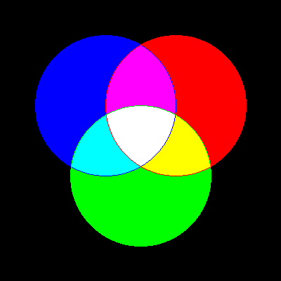
RGB MODEL
Add red, green and blue to create colors, so it is an additive model.
Assigns an intensity value to each pixel ranging from 0 (black) to 255 (white)
  A bright red color might have R 246, G 20, B 50

Slide 37
HSB MODEL
Based on human perception of color, describe three fundamental properties of color:
  Hue
  Saturation (or chroma)
  Brightness - relative lightness or darkness of color, also measured as %
There is no HSB mode for creating or editing images

Slide 38
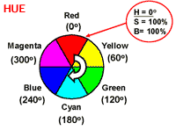
HSB MODEL
Hue - color reflected from or transmitted through an object, measured on color wheel

Slide 39
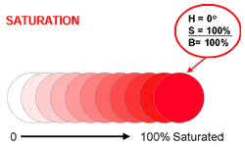
HSB MODEL
Saturation (or chroma) - strength or purity of color (% of grey in proportion to hue)

Slide 40
HSB MODEL
Brightness - relative lightness or darkness of color, also measured as %
0%
50%
100%
Black |  |  |  |  |  |  |  |  | white

Slide 41
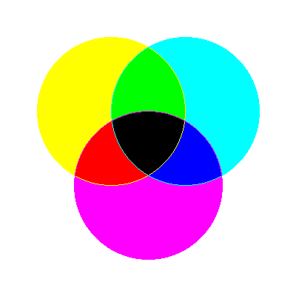
CMYK MODEL
Based on light-absorbing quality of ink printed on paper
As light is absorbed, part of the spectrum is absorbed and part is reflected back to eyes
Associated with printing; called a subtractive model
Four channels: Cyan (C ), magenta (M), yellow (Y) and black (K)
In theory, pure colors should produce black, but printing inks contain impurities, so this combination produces muddy brown
K is needed to produce pure black, hence CMYK is four-color process printing

Slide 42
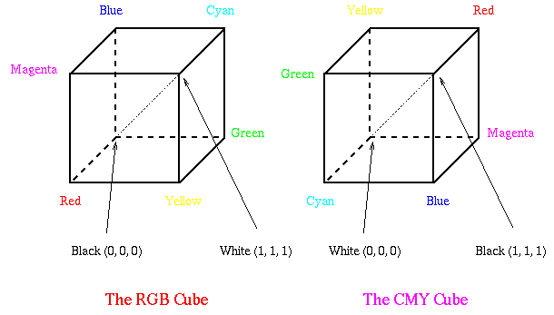


RGB AND CMY
Converting between RGB and CMY

Slide 43
COLOR PALETTES
Palettes are mathematical tables that define the color of pixels displayed on the screen.
Palettes are called ‘color lookup tables’ or CLUTs on Macintosh.
The most common palettes are 1, 4, 8, 16, and 24-bit deep.

Slide 44
COLOR PALETTES
Dithering:
  Dithering is a process whereby the color value of each pixel is changed to the closest matching color value in the target palette.
  This is done using a mathematical algorithm.

Slide 45
INFORMATION DELIVERY
Images or Graphics are used to convey information in multimedia products.
For example, a picture of an automobile engine is much more effective than text that merely describes it.

Slide 46
INFORMATION DELIVERY
Images or Graphics for information delivery include:
  Drawn images
  Charts and graphs
  Maps
  Scenery
  People

Slide 47
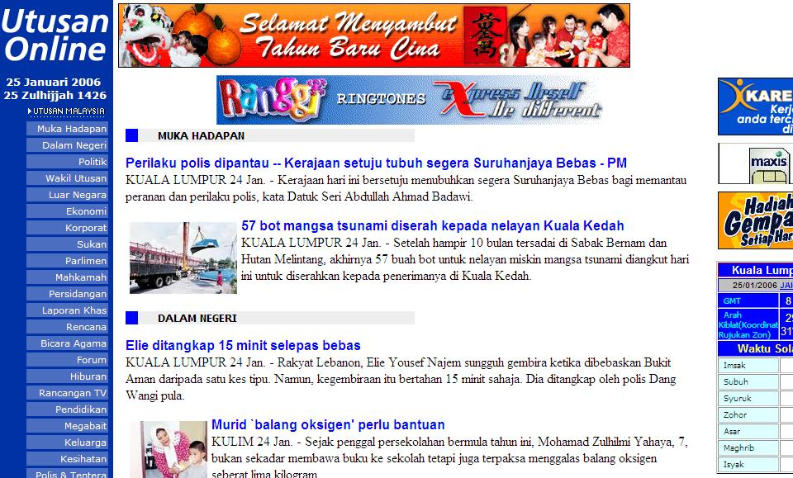
INFORMATION DELIVERY
In each case, the image must be relevant to the overall product.
Image size, color in respect to the application and other images, and positioning must all be considered when using images.

Slide 48
IMAGE FORMAT CONVERSION
It means to convert a format of an image to another.

Slide 49
IMAGE FILE TYPES USED IN MULTIMEDIA
Macintosh formats.
Windows formats.
Cross-platform formats.

Slide 50
MACINTOSH FORMATS
On the Macintosh, the most commonly used format is PICT.
PICT is a complicated and versatile format developed by Apple.
Almost every image application on the Macintosh can import or export PICT files.
In a PICT file, both vector-drawn objects and bitmaps can reside side-by-side.

Slide 51
WINDOWS FORMATS
The most commonly used image file format on Windows is DIB.
DIB stands for Device-independent bitmaps.
The preferred file type for multimedia developers in Windows is Resource Interchange File Format (RIFF).

Slide 52
Windows Formats
Bitmap formats used most often by Windows developers are:
  BMP - A Windows bitmap file.
    Native bitmap file format of the Microsoft Windows environment
  TIFF - Extensively used in DTP packages.
    Used to exchange documents between different applications and platforms
  PCX - Used by MS-DOS paint software.
    One of the oldest bitmapped formats popularized by MS-DOS paint programs that first appeared in the early 1980's

Slide 53
BMP (BITMAP)
The Windows Bitmap or BMP files are image files within the Microsoft Windows operating system. In fact, it was at one point one of the few image formats. These files are large and uncompressed, but the images are rich in color, high in quality, simple and compatible in all Windows OS and programs. BMP files are also called raster or paint images.
BMP files are made of millions and millions of dots called ‘pixels’, with different colors and arrangements to come up with an image or pattern. It might an 8-bit, 16-bit or 24-bit image. Thus when you make a BMP image larger or smaller, you are making the individual pixels larger, and thus making the shapes look fuzzy and jagged.
BMP files are not great and not very popular. Being oversized, bitmap files are not what you call ‘web friendly’, nor are they compatible in all platforms and they do not scale well.

Slide 54
BMP CONTD..
Pros of BMP:
Works well with most Windows programs and OS, you can use it as a Windows wallpaper
Cons of BMP:
Does not scale or compress well
Again, very huge image files making it not web friendly
No real advantage over other image formats

Slide 55
TIFF (TAGGED IMAGE FILE FORMAT)
TIFF was created by Aldus for ‘desktop publishing’, and by 2009 it was transferred to the control of Adobe Systems. TIFF is popular among common users, but has gained recognition in the graphic design, publishing and photography industry. It is also popular among Apple users.
TIFF is not compatible for all systems.

Slide 56
TIFF CONTD..
The TIFF image format is easy to use with software that deals with page layout, publishing and photo manipulation via fax, scanning, word processing, etc. TIFF is very flexible, it can be lossy or lossless. TIFF is a rich format and supported by many imaging programs. It is capable of recording halftone image data with different pixel intensities, thus is the perfect format for graphic storage, processing and printing. This makes TIFF the superior raster image format.

Slide 57
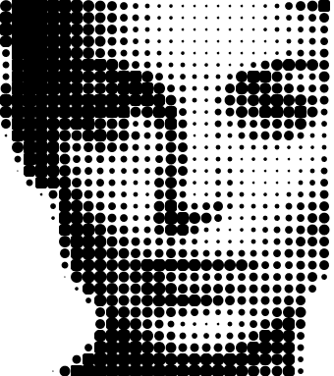

Slide 58
TIFF CONTD..
Pros of TIFF:
Very flexible format, it supports several types of compression like JPEG, ZIP or no compression at all.
High quality image format, all color and data information are stored
TIFF format can now be saved with layers
Cons of TIFF:
Very large file size–long transfer time, huge disk space consumption, and slow loading time.

Slide 59
CROSS-PLATFORM FORMATS
The image file formats that are compatible across platforms are:
    DXF - Used by CAD applications.
    Initial Graphics Exchange Standard (IGS or IGES) - Standard for transferring CAD drawings.
    JPEG and GIF - Most commonly used formats on the Web.
Notes:
Drawing eXchange Format

Slide 60
JPEG (JOINT PHOTOGRAPHIC EXPERTS GROUP)
JPEG is the most popular among the image formats used on the web. JPEG files are very ‘lossy’, meaning so much information is lost from the original image when you save it in JPEG file. This is because JPEG discards most of the information to keep the image file size small; which means some degree of quality is also lost.
Almost every digital camera can shoot and save in the JPEG format. JPEG is very web friendly because the file is smaller, which means it takes up less room, and requires less time to transfer to a sites. Since 1994, JPEG has been considered the standard.

Slide 61
JPEG CONTD..
Pros of JPEG:
24-bit color, with up to 16 million colors
Rich colors, great for photographs that needs fine attention to color detail
Most used and most widely accepted image format
Compatible in most OS (Mac, PC, Linux)
Cons of JPEG:
They tend to discard a lot of data
After compression, JPEG tends to create artifacts
Cannot be animated
Does not support transparency

Slide 62
GIF (GRAPHICS INTERCHANGE FORMAT)
GIF is limited to the 8 bit palette with only 256 colors. GIF is still a popular image format on the internet because image size is relatively small compared to other image compression types.
GIF compresses images in two ways: First, by reducing the number of colors in rich color images, thus reducing the number of bits per pixel. Second, GIF replaces multiple occurring patterns (large patterns) into one. So instead of storing five kinds of blue, it stores only one blue.

Slide 63
GIF CONTD..
GIF is most suitable for graphics, diagrams, cartoons and logos with relatively few colors. GIF is still the chosen format for animation effects.
Compared to JPEG, it is lossless and thus more effective with compressing images with a single color, but pales in detailed or dithered pictures. In other words, GIF is lossless for images with 256 colors and below. So for a full color image, it may lose up to 99.998% of its colors.
One edge of the GIF image format is the interlacing feature, giving the illusion of fast loading graphics. When it loads in a browser, the GIF first appears to be blurry and fuzzy, but as soon as more data is downloaded, the image becomes more defined until all the data has been downloaded.
  For large areas of the same color and a moderate level of detail.
  Allows transparency and interlacing
  Uses lossless compression

Slide 64
GIF CONTD..
Pros of GIF:
Can support transparency
Can do small animation effects
‘Lossless’ quality–they contain the same amount of quality as the original, except of course it now only has 256 colors
Great for images with limited colors, or with flat regions of color
Cons of GIF:
Only supports 256 colors
It’s the oldest format in the web, having existed since 1989. It hasn’t been updated since, and sometimes, the file size is larger than PNG.

Slide 65
MOST POPULAR IMAGE FILE FORMATS
The most popular image file formats are JPEG, GIF and PNG.
Other formats:
  BMP, PSD, TIFF/TIF, TGA, EPS, PCX, ICO

Slide 66
PNG (PORTABLE NETWORK GRAPHICS)
PNG is a recently introduced format, so not everyone familiar with it. But PNG has been approved as a standard since 1996. It is an image format specifically designed for the web. PNG is, in all aspects, the superior version of the GIF. Just like the GIF format, the PNG is saved with 256 colors maximum but it saves the color information more efficiently. It also supports an 8 bit transparency.
  Support indexed-color, gray scale, and true color images + an optional alpha channel for transparency

Slide 67
PNG CONTD..
PNG was actually created for the intent to replace the GIF as an image format that doesn’t require a patent license. PNG can support 24 bit RGB color images, gray scale images, both with and without alpha channels. RGB cannot support CMYK color spaces, and is not designed for print graphics.

Slide 68
PNG CONTD..
Pros of PNG:
Lossless, so it does not lose quality and detail after image compression
  portable, well-compressed storage of raster images
  patent-free replacement for GIF
  also replace many common uses of TIFF
In a lot ways better then GIF. To start, PNG often creates smaller file sizes than GIF
Supports transparency better than GIF
Cons of PNG:
Not good for large images because they tend to generate a very large file, sometimes creating larger files than JPEG.
Unlike GIF however, it cannot be animated.
Not all web browsers can support PNG.

Slide 69
SUMMARY
The computer generates still images as bitmaps and vector-drawn images.
Images can be incorporated in multimedia using clip arts, bitmap software, or by capturing, editing, or scanning images.
Creating 3-D images involves modeling, extruding, lathing, shading, and rendering.
Color is one of the most vital components of multimedia.

